Slide 1
Deep Learning for Sequences in Quantitative Finance
CS2470
Brown University
Andrew Kent
andrew_kent@brown.edu

Slide 2
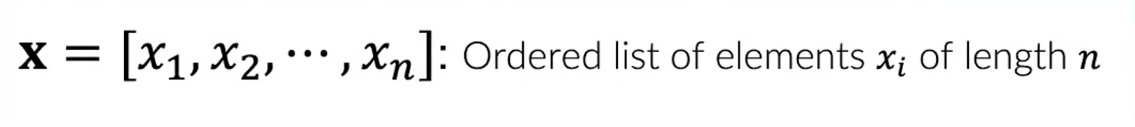
sequences
Text: NLP
Speech: Audio Signal
Music: Audio Signal
Video: Sequence of image frames
Stock prices

Slide 3
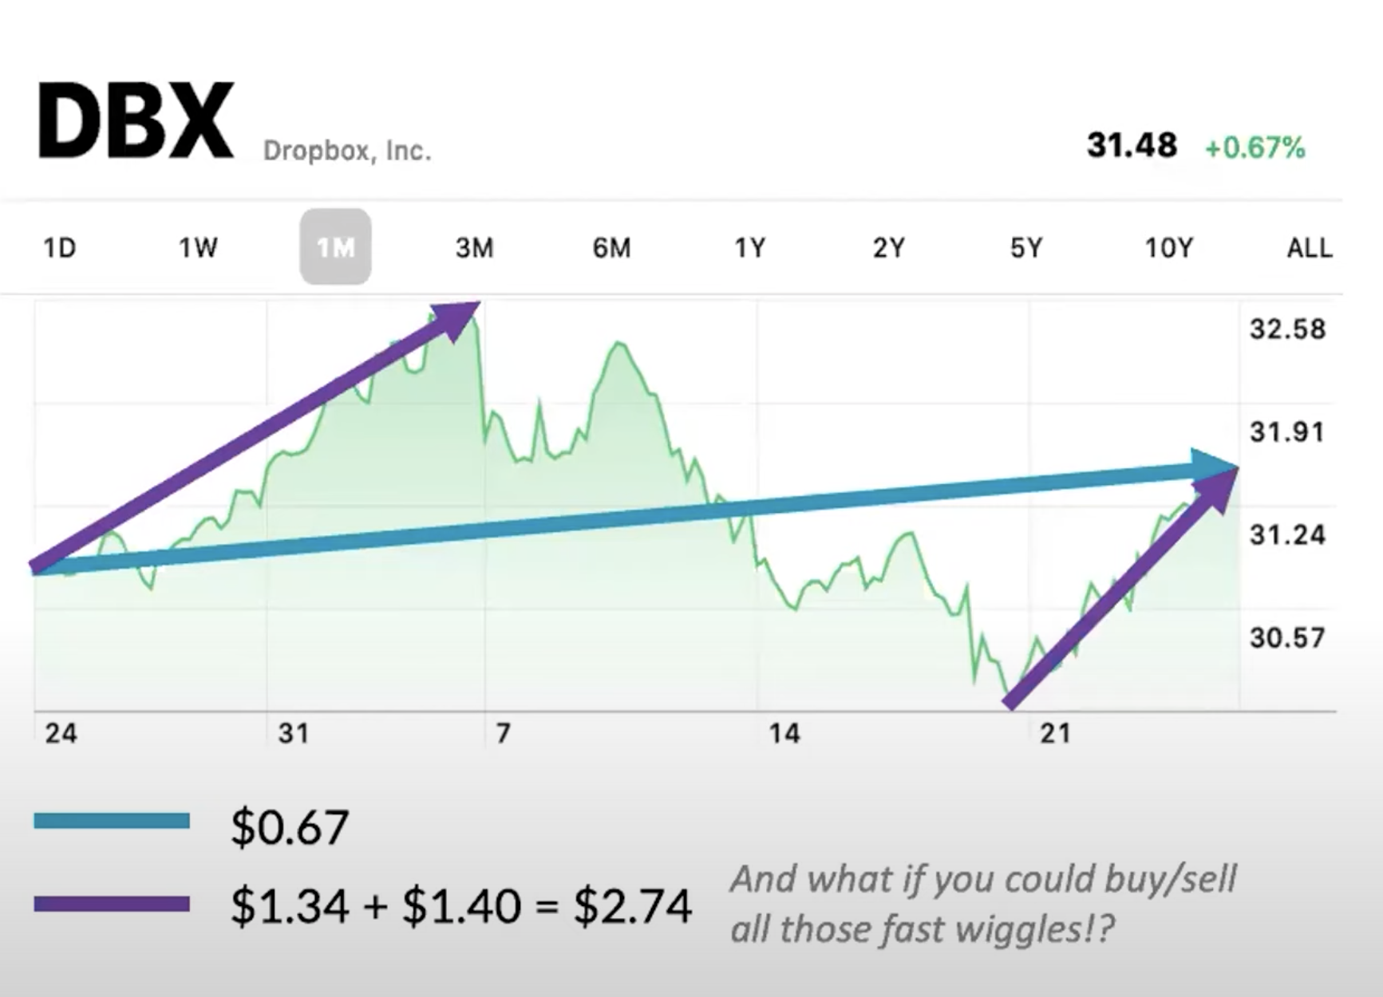
How do you make money in the stock market?
“Buy low and sell High”
“Buy the dip”
“Don’t put all your eggs in one basket”
(Portfolio Diversification)
“Don’t time the market”
Yes and no
“Don’t let your emotions cloud your judgements”

Slide 4
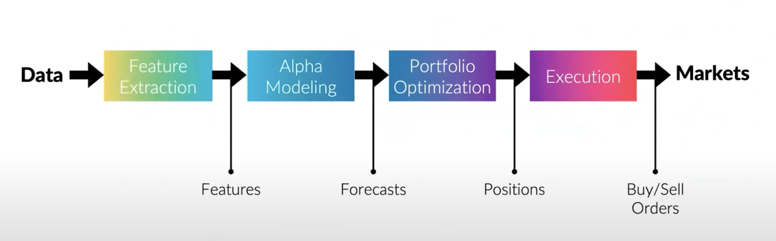
Quantitative investment pipeline

Slide 5
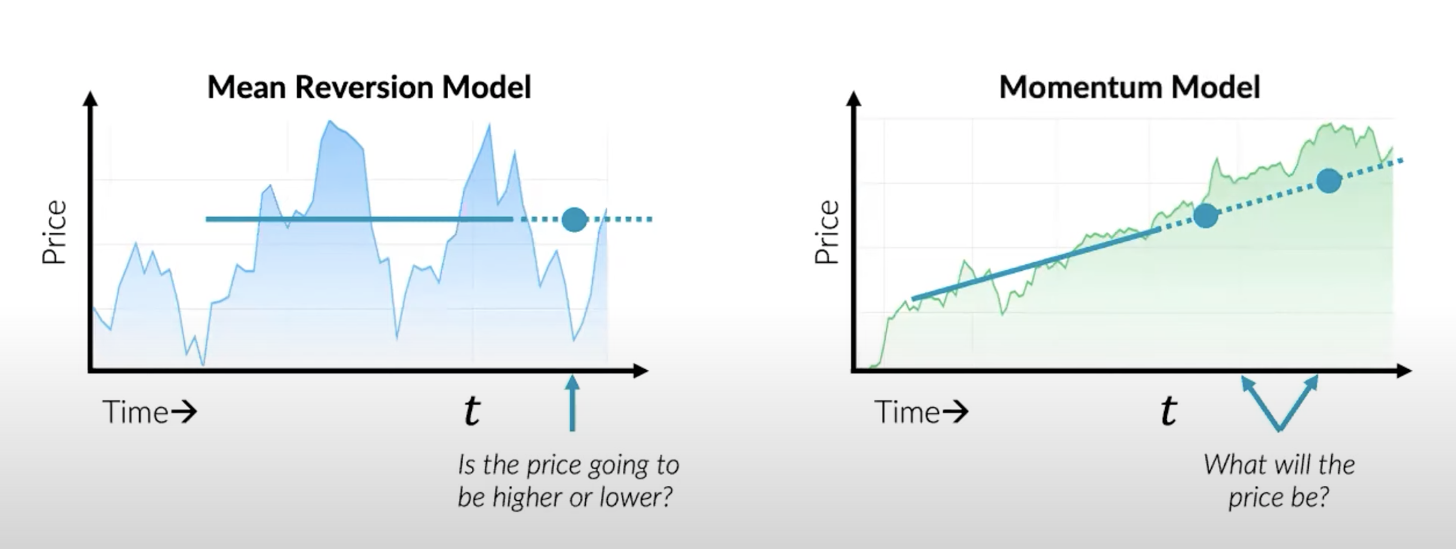
Alpha modeling
Given information about a financial instrument until time t, is the price going to be higher or lower?
Can we predict its future Price?

Slide 6
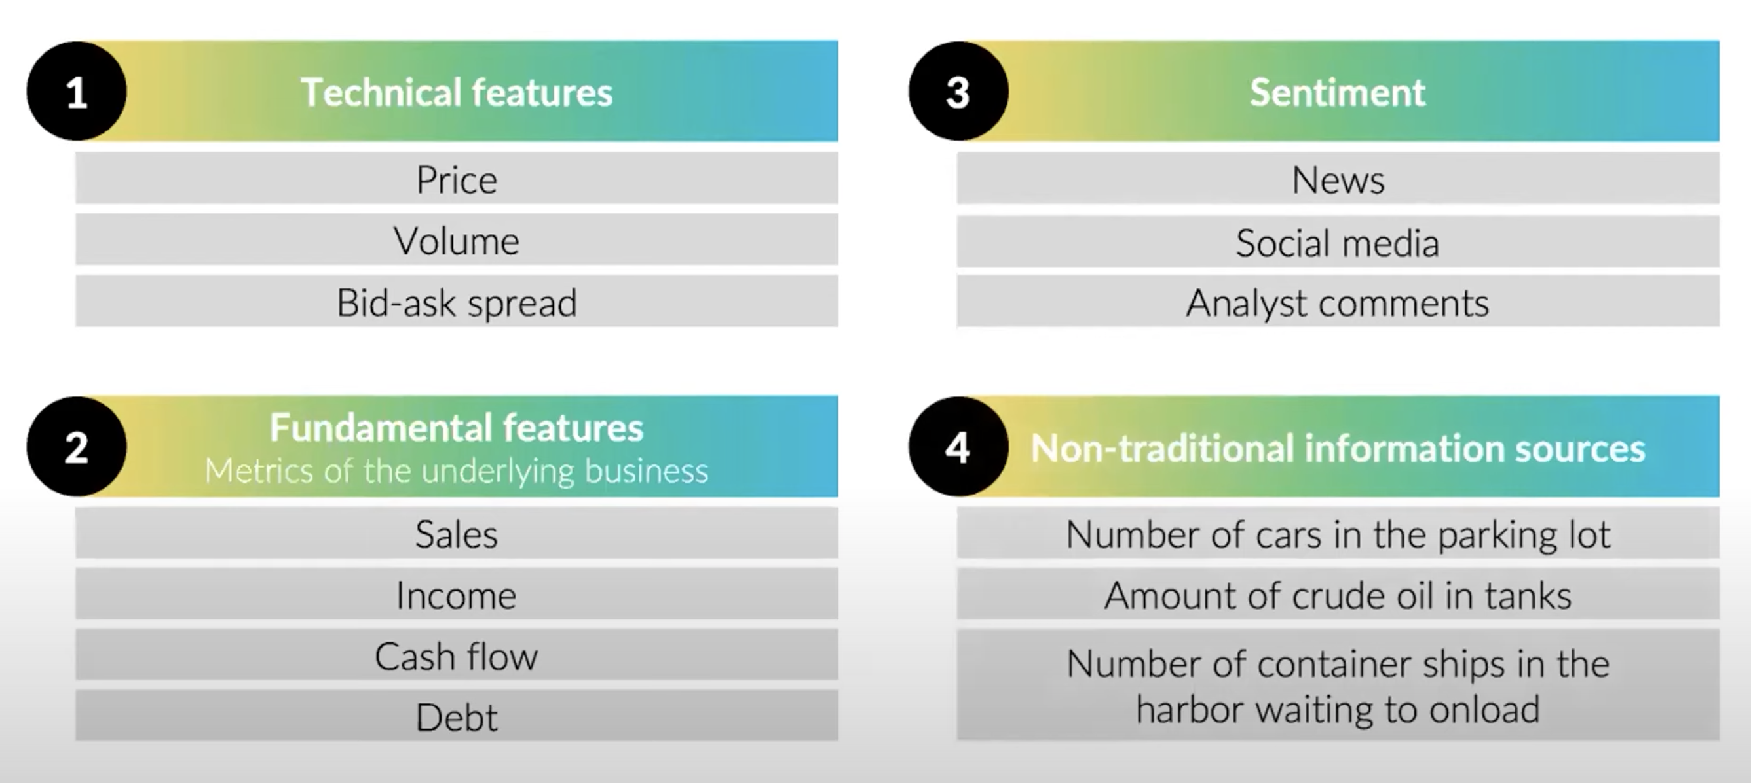
Feature extraction

Slide 7
Project Description
Both weather and stock data are sequential
LSTM, CNN-LSTM and CNN-LSTM-Self Attn models
Forecast stock prices → weather data to refine these predictions
Use multiple input models of stock & weather data features
Inspired by previous LSTM models that only use one of the two: stock data to predict future price, or weather data to forecast the weather.
We want to investigate the best way to combine the two.

Slide 8
Datasets and Preprocessing
Very different sets of data: financial & meteorological
Stock data obtained from the Yahoo finance library
This data is conveniently processed into daily opening/closing price, highest/lowest price, volume and turnover.
Weather data obtained from the National Oceanic and Atmospheric Administration
This data is incomplete, corrupted and has too many columns
We only use daily temperature, precipitation, wind direction and pressure
Must make sure we have the same dates as the stock data (e.g. the stock market is open only 5 days a week)
Processing was done using pandas dataframes

Slide 9
Model Architecture
Input
CNN
Sequential Self-Attention
Dense
LSTM
Output
Pooling
Input
CNN
LSTM
Dense
Pooling
Output
Input
LSTM
Dense
Output
Benchmark vanilla LSTM model
CNN-LSTM model
CNN-LSTM-SelfAtten model

Slide 10
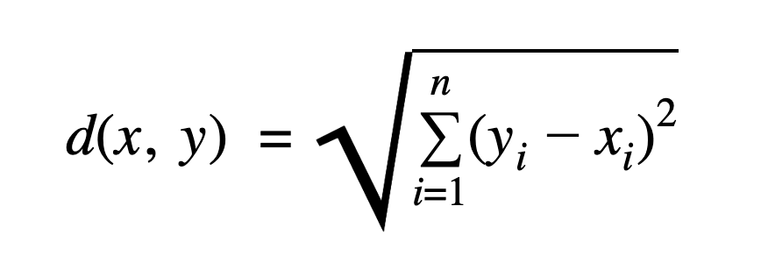
Evaluation & Metrics
Success is easy to quantify for this kind of project
Accuracy is to minimize the normalized difference & normalized squared difference between our predictions and the real stock price

Slide 11
STUDY of Molson Coors’s stock price
We expect the stock to be influenced by the temperature because most of Budlight’s hops (up to 70%) come from one farm in Idaho.

Slide 12
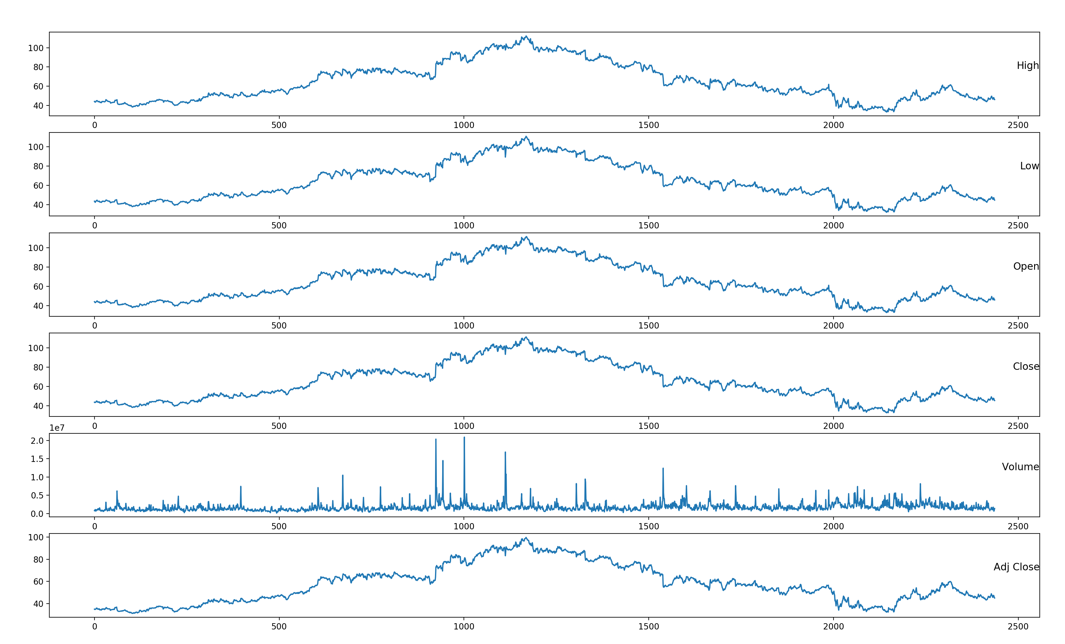
Molson Coors’s Stock Data

Slide 13
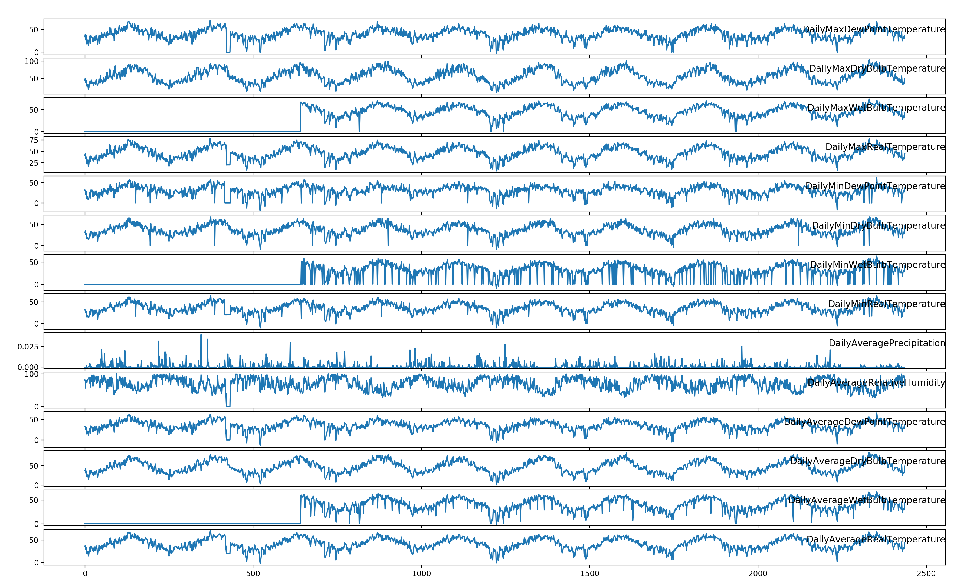
Elk Mountain Farms Weather Data

Slide 14
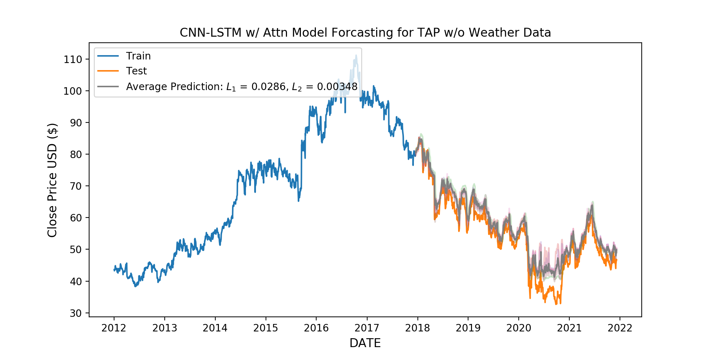
Prediction using price only CNN-LSTM-SelfAtten

Slide 15
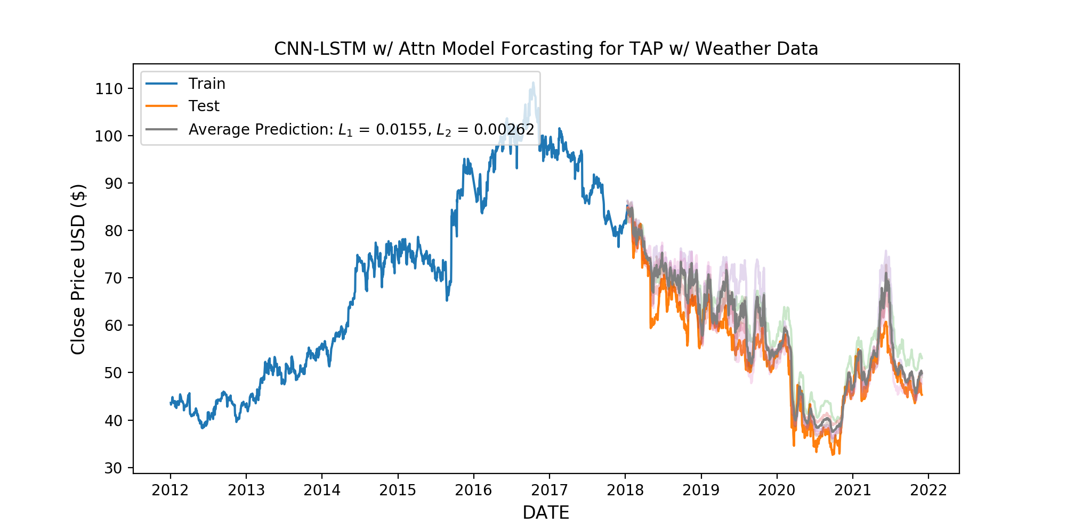
Prediction using price and weather CNN-LSTM-SelfAtten
Using the weather data the model was better able to predict
the large downturn at the start of 2020 much better than without
L1 and L2 scores both went down by ~30-40%, and indication that the additional data helped the model

Slide 16
STUDY of JPMorgan Chase & Co.’s stock price
We expect the stock NOT to be influenced by the temperature data for a particular region in Idaho

Slide 17
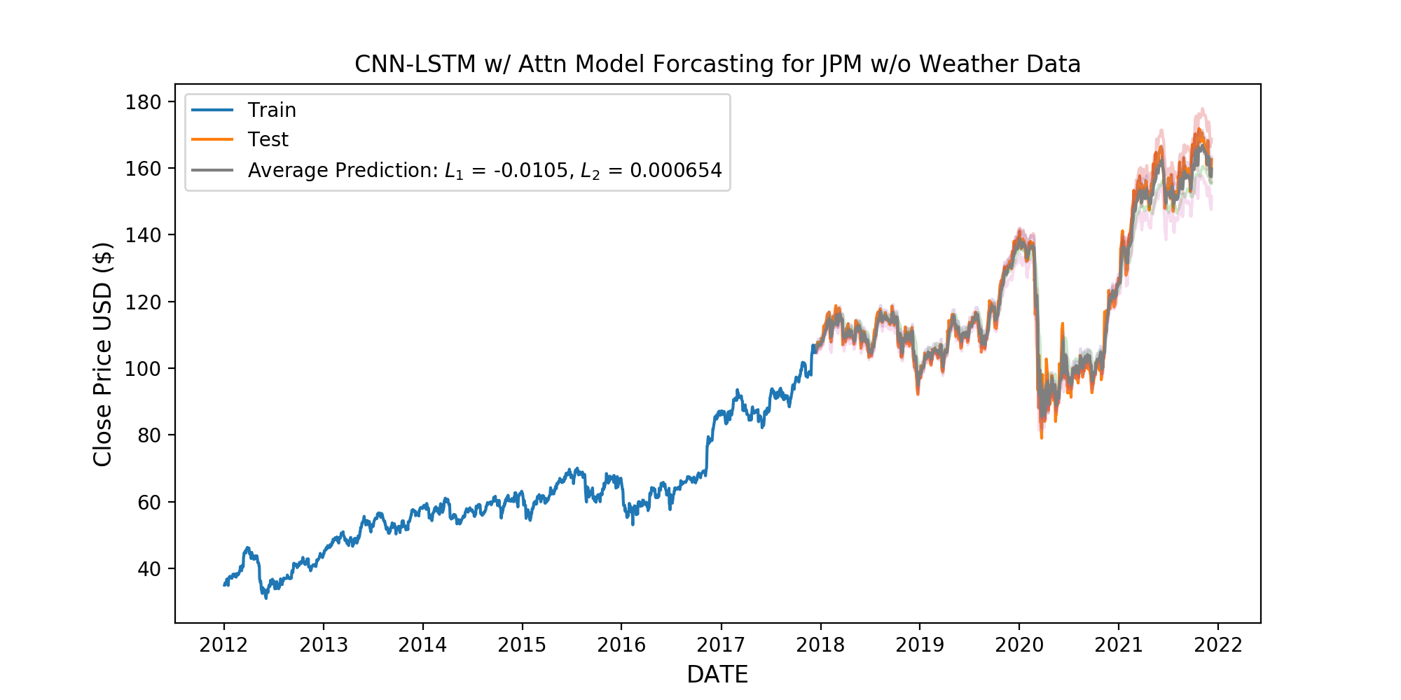
Prediction using price only CNN-LSTM-SelfAtten
Excellent predictions with only stock data, even being able to predict patterns not visually similar to the training data.

Slide 18
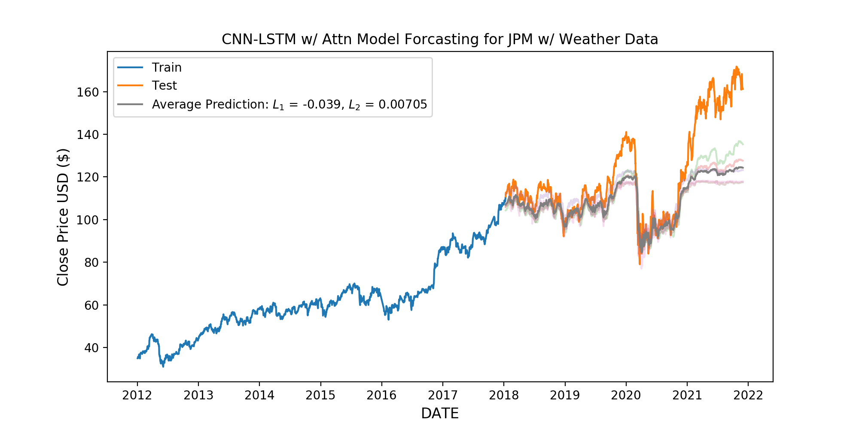
Prediction using price and weather CNN-LSTM-SelfAttn
The quality of the prediction became about three times worse with the weather data , no doubt a result of the model being confused with which data was most important for the future predictions.
Of the three models, the CNN-LSTM-ATTN proved to do the best with the weather data, we’re sure in part due to the model being designed to differentiate between “good” and “bad” data

Slide 19
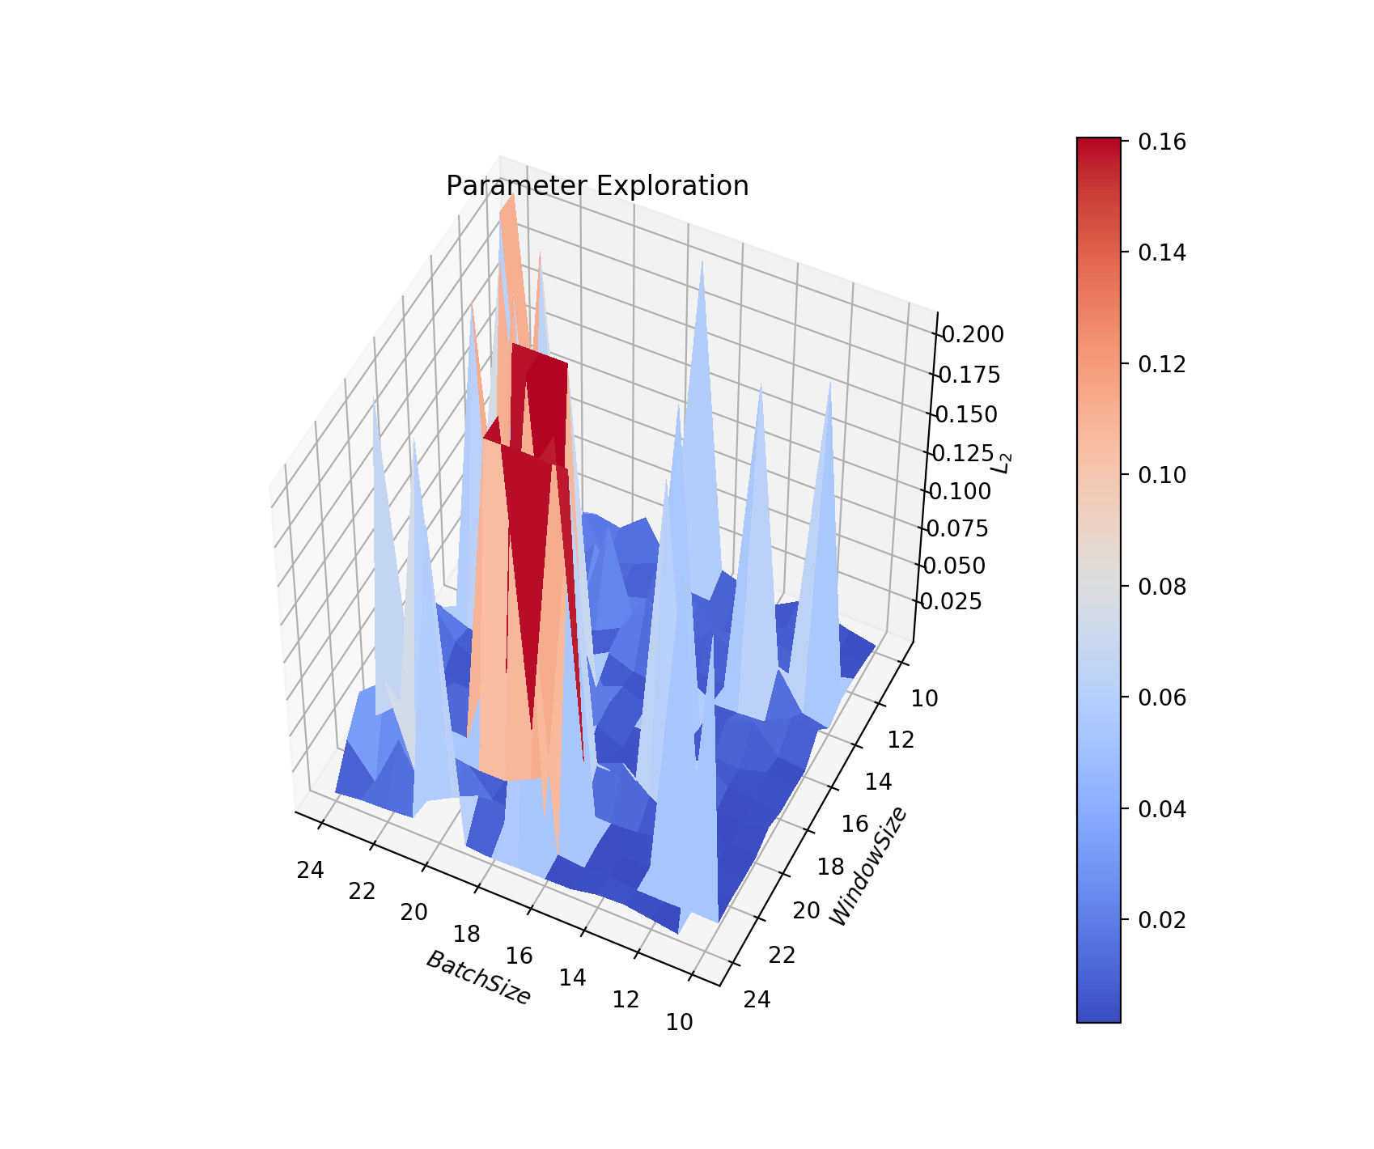
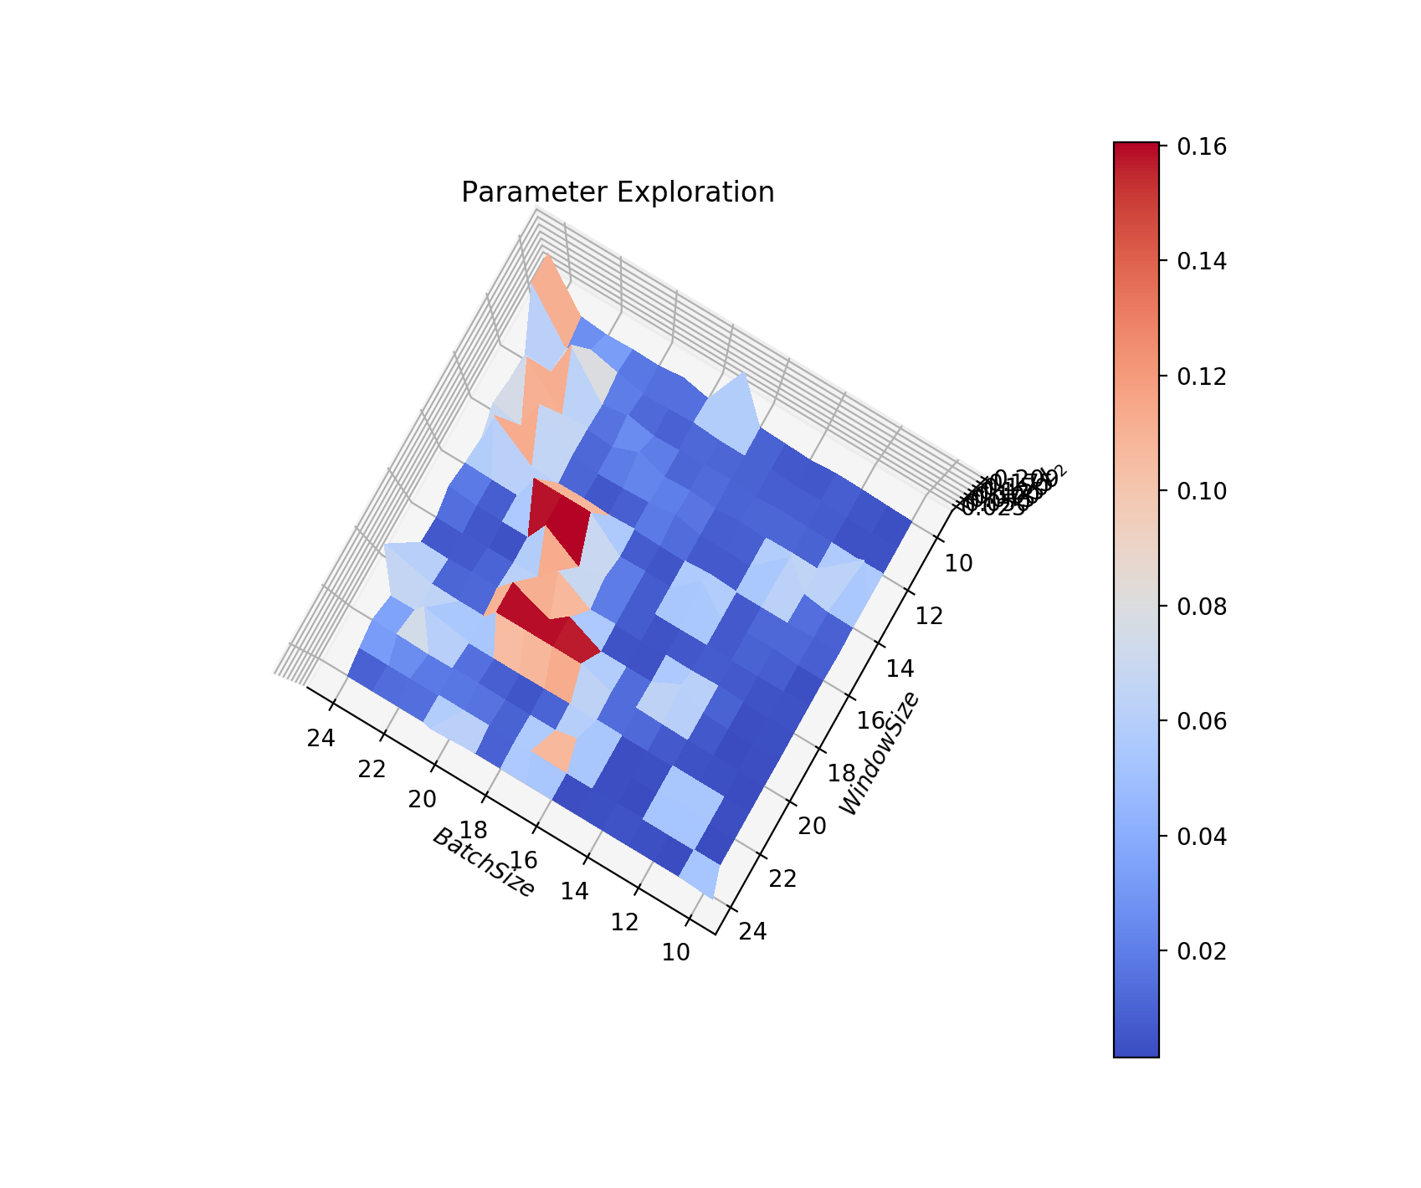
Parameter Exploration

Slide 20
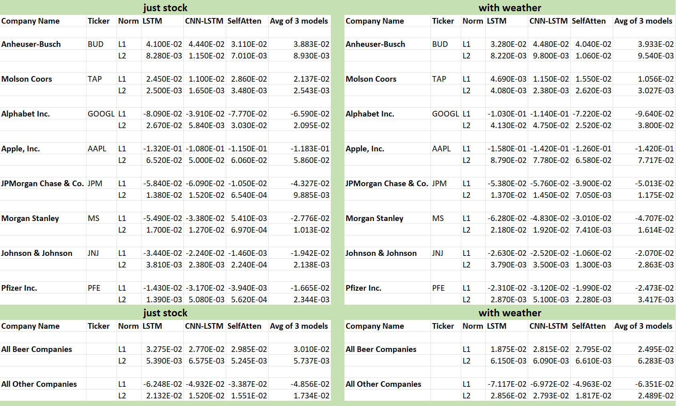
Model Comparison

Slide 21

Model Takeaways
The model works “really well” whenever we have some connection between the weather data and the company whose stock we are considering
In particular, the weather data helps with the beer companies’ stock, but not with the banking stocks
The models are fairly easy to train once one fine good hyperparameters – we were able to run them on local laptops

Slide 22
Model Challenges
Predicting stock with weather is not something that was previously explored in detail (comment)
Relevant data collection is difficult because the data needs to be high frequency and high fidelity
Processing big amount of data requires a big processing power
Data integration required some thinking because the stock data is only 5 days a week
Bigger window size can wash out some details about the stocks

Slide 23
Next Steps
Gather min-by-min stock data for higher fidelity predictions
Introduce fine-tuning methods such as masking data and blind training
Do a more careful study, including multiple companies that have some relation to the weather and add additional data to train on
Self Predict
RL agent portfolio management

Slide 24
Questions?
Run the Code! https://github.com/AndrewTKent/Quantitative_Finance
Ask me questions in email! andrew_kent@brown.edu

